Slide 1
Interview Status Prediction
Author:- Rohith Narayanan S
Batch:- CIT-PGA-001

Slide 2
The Business Problem
Problem Abstract
Problem statement
Target Approach
A data scientist of a big MNC who usually hires more than 10k candidates every year. To complete the task they conduct more than 1 lakhs of interviews every year.
Need to predict the status of the interviews so that recruiters can check the sanity of the interview and find if the interview was biased.
To predict the “Status” column using Classifier Machine Learning Algorithms.

Slide 3
Challenges Faced (Deep-Dive)
Challenge 1
Challenge 2
Challenge 3
Columns
The dataset consists of many features consisting of both numerical (Major) and categorical(Minor) values, hence feature understanding need to be done efficiently.
Feature Selection
The Correlation the columns were unique because it consists of very low positive values and high negative values except S.L.R.C & S.L.R.I Columns.
Model Predictions
By Trailing and Testing the data with ML models to get a close to perfect prediction score.

Slide 4
Solution
Support Vector Machines Classifier ML Algorithm was the best model when comparing with other models and considering this dataset.
SVM Classifier

Slide 5
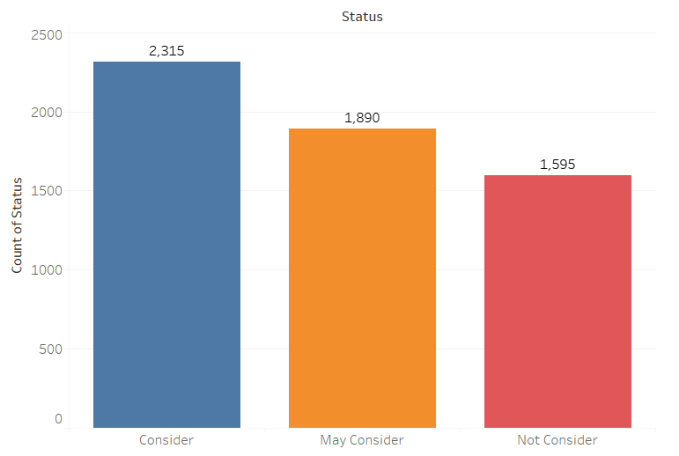
Target Feature - Status
The Target feature “Status” has 3 unique values in it, namely ‘Consider’, ‘May Consider’ & ‘Not Consider’.
The “Status” feature is has poor correlation with each and every feature in the dataset.
The Majority of the candidates were considers in this company.

Slide 6

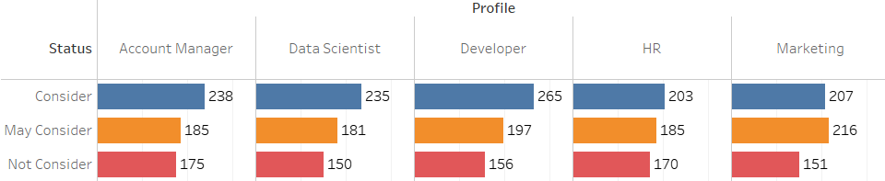
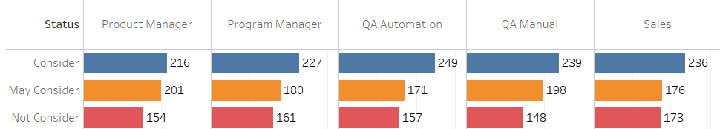
Interesting Findings
Low Data Correlation
Diversity in Data

Slide 7
Implementation of the Solution

Slide 8
Feature Understanding of the dataset
Preparing the dataset for Modeling by Encoding the columns
Splitting the dataset into train and test datasets
Understanding
Cleaning
Preparing
Selection
Splitting
Model Build
Cleaning the dataset of noises and outliers
Selecting the Features based on relevance and Correlation
Building and initiating several models

Slide 9
Training the Models with the training dataset
Comparing each Model’s training & testing score
Selecting the best Model
Training
Testing
Compare
Tuning
Model Selection
Implementing
Testing the Models for accuracy
Change the Hyper Parameters of all the Models for better performance
Implementing the selected Model

Slide 10
Final Accuracy Score
Train Score: 0.9982758620689656
Test Score: 0.9942528735632183
Submission Score: 0.708
Source Code: RohithNarayananS/Imarticus-Hackathon-Round-3 (github.com)
LinkedIn: linkedin.com/in/rohith-narayanan-61630318b

